Slide 1


Social Buzz
Data-Analysis
By Dinesh Rawat

Slide 2


Today's agenda
Project recap
Problem
Process
Insights
Summary

Slide 3


Social Buzz was founded by two former engineers from a large social media conglomerate. Over the past 5 years, Social Buzz has reached over 500 million active users each month. They have scaled quicker than anticipated and need the help of an advisory firm to oversee their scaling process effectively.
Our team has been assigned with a task to provide data insights on client Social Buzz Data at Accenture
Understand the client and business problem at hand.
Identify the requirements that need to be delivered for this project.
Identify which tasks you should focus on as a Data Analyst.
Project Recap

Slide 4


Problem
To start our engagement with Social Buzz, we are running a 3 month initial project in order to prove to them that we are the best firm to work with.
They are expecting the following: -
Recommendations for a successful IPO by increasing their profit from the content.
An analysis of their content categories that highlights the top 5 categories with the largest aggregate popularity

Slide 5

Process
1
Details of content
How to use the details to get insights
Data Understanding
2
Data Cleaning
Removing Empty values
Removing unnecessary details
3
Making Modification in the data set to get more useful insights
Combing the different data sets
Data modelling
4
Data Analysis
Visualizing data
Analyzing the scores
5
Data Insights
Giving recommendation on the basis of our analysis

Slide 6
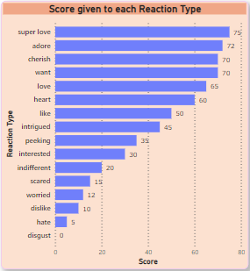
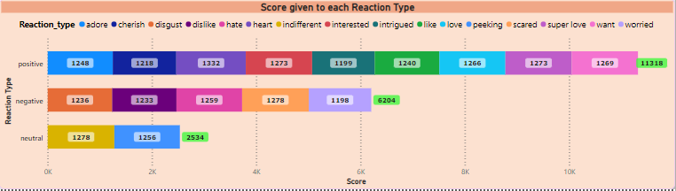

Insights
Super is the reaction with the Highest score of 75
Disgust is the reaction with the Lowest score of 0
Heart is the reaction given maximum number of time.
Worried is the reaction given minimum number of time.

Slide 7
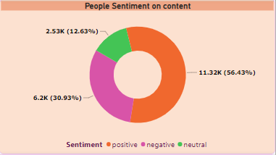
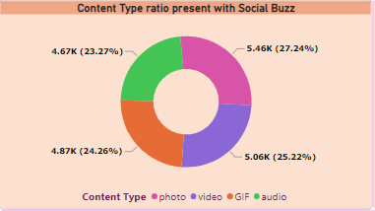
Insights
Positive Content are more in number in social Buzz
Photo Content are more in number in Social Buzz

Slide 8
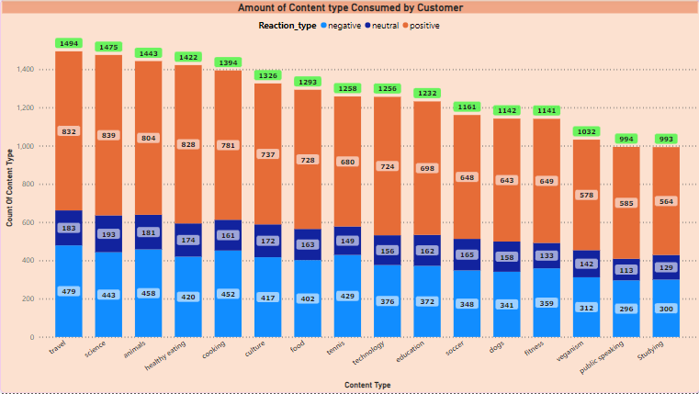
Insights

Slide 9
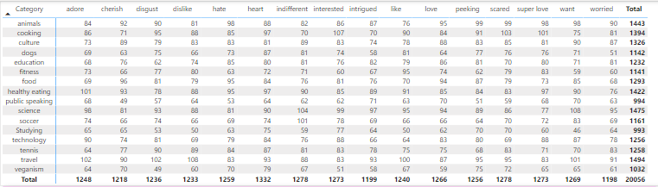
Number of each reaction type given to each content type

Slide 10


Analysis:
Travel and science are the most watched and are with the highest score which means people like the factual and travelling content.
Category related to food is the most common content watched by the user in different category.
Summary

Slide 11

Thank you!
ANY QUESTIONS?

